Slide 1

Car Rentals & Mobility App
Design and Development for Rental Self Service
A web-based platform to search, book, pay, pick up and return a car without a rental counter, backed by a relational database.
Search → Select → Book → Pay →
Pick Up → Ride → Return
Team Members (Team No. 9)
2520030122 – Akshith Reddy
2520030026 – B. Pranavi
2520030140 – V. Charishma
Guide: Dr. S. Spandana | Department of CSE, KL University
Section-07 | Database Systems Engineering and Distributed Backend Development (25CS1302E)

Slide 2
Abstract
Car Rentals & Mobility App for Rental Self Service
Renting a car is still slow and manual: office visits, paperwork and waiting for staff.
This project is a web-based self-service platform for renting cars.
Users search cars by location and dates, compare prices, book and pay online.
Users can track booking status and view their full rental history.
The rental amount is calculated automatically.
The same car can never be booked twice for the same period.
Admins manage vehicles, bookings, customers, returns and revenue.
Built with HTML, CSS, JavaScript, Node.js, Express and MySQL.

Slide 3
Problem Statement
Why traditional car rental falls short
Time-consuming process
Enquiry, documents, payment and handover must all be done in person.
No availability information
Customers cannot see which vehicles are free for their dates.
Hard to compare prices
Categories, fuel types and rates are shared verbally or in brochures.
Manual operations
Booking, payment and return depend on staff, causing clerical errors.
Double booking
The same vehicle can be promised twice for overlapping periods.
Poor record keeping
Rental history and payments are hard to trace for planning.
Need: a simple, reliable self-service platform with real-time access and one consistent record of every rental.

Slide 4
Project Objectives
What the system is designed to achieve
1
2
3
4
Easy booking
Search and reserve a vehicle in a few steps.
Save time
Remove waiting and manual paperwork.
Live availability
Show only cars free for the chosen place and period.
Secure transactions
Reliable payment and booking records; hashed passwords.
5
6
7
8
Better experience
Simple, responsive and user-friendly interface.
Efficient management
One dashboard for vehicles, bookings and customers.
Data integrity
Normalisation, constraints, indexes and transactions.
Academic goal
Show ER modelling, SQL, views and triggers in a real app.

Slide 5
Proposed System
One platform for two roles, one central database
CUSTOMER
ADMINISTRATOR
Search and filter by location, period, type, fuel and price
Compare vehicles and view live availability
Book with automatic price and online payment
Self-service pickup, return and trip history
Rate and review completed trips
Add, update and deactivate vehicles
Monitor all bookings and their status
Manage customers
Record returns, late fees and damage charges
Track revenue with SQL reports
CENTRALISED MYSQL DATABASE
Users • Vehicles • Locations • Bookings • Payments • Returns • Reviews

Slide 6
End-to-End Workflow
From search to return, with a clear booking life cycle
RENTAL JOURNEY
01
Search
02
Select
03
Book
04
Pay
05
Pick Up
06
Ride
07
Return
›
›
›
›
›
›
Location and dates
Compare and pick
Price auto-calculated
Online payment
Digital pass
Use the vehicle
Charges settled
BOOKING STATUS LIFE CYCLE
pending
›
confirmed
›
active
›
completed
cancelled
POST /api/bookings
POST /api/payments
Pickup confirmation
POST /api/returns
User, admin or timeout
A vehicle is held while a booking is pending, confirmed or active, so no other customer can take it for the same period.

Slide 7
System Architecture
Three-tier design: presentation, application and data layers
PRESENTATION LAYER
Browser front end
HTML5 • CSS3 • JavaScript (ES6+)
Vehicle cards, search and filters, booking, payment and admin screens; responsive on phone and desktop.
Users
Customers and administrators with role-based access.
REST / JSON + JWT
APPLICATION LAYER
Node.js + Express
Routes: auth, vehicles, bookings, payments, returns, admin
Middleware: JWT verification, role check, input validation, CORS.
Payment gateway
Sandbox / simulated; Razorpay or Stripe can plug in.
SQL via mysql2 pool
DATA LAYER
MySQL (InnoDB)
Tables with foreign keys and CHECK constraints, composite indexes
Views, triggers (audit trail), stored procedures and ACID transactions.
Security
bcrypt-hashed passwords; parameterised queries.

Slide 8
Core Modules
Eight functional building blocks sharing one database
1
2
3
4
User Management
Register, log in, profile and roles.
Vehicle Management
Add vehicles, set rates and status, move locations.
Search & Availability
Free cars by location, period and filters.
Booking Management
Availability re-check, price and booking in a transaction.
5
6
7
8
Payment & Billing
Record each attempt; confirm the booking on success.
Pick-up & Return
Odometer, late fee, damage charge, vehicle freed.
History & Reviews
Past trips with payments, and 1–5 ratings.
Admin Dashboard
Counts, recent bookings and revenue reports.

Slide 9
Database Design
ER model converted to a relational schema, normalised to 3NF
LOCATIONS
location_id, city, address
1:N
VEHICLES
vehicle_id, registration_no, daily_rate, status
1:N
VEHICLE_CATEGORIES
category_id, category_name
Design highlights
3NF: category and location details kept in their own tables
Index on bookings (vehicle_id, start, end) speeds overlap checks
CHECK: rate > 0, end > start, rating 1–5
Foreign keys use RESTRICT to protect history
total_amount stored so the agreed price stays fixed
1:N
USERS
user_id, email, license_no, role
1:N
BOOKINGS
booking_id, start/end_datetime, total_amount, status
log
BOOKING_AUDIT
old_status, new_status (trigger)
1:N
1:0..1
1:0..1
PAYMENTS
payment_id, amount, status, transaction_ref
VEHICLE_RETURNS
late_fee, damage_charge, odometer
REVIEWS
rating (1–5), comment

Slide 10
Double-Booking Prevention
Transaction-safe booking with row-level locking
Lock the vehicle row
SELECT … FOR UPDATE makes concurrent requests wait.
BEGIN;
SELECT daily_rate FROM vehicles
WHERE vehicle_id = ? FOR UPDATE;
SELECT booking_id FROM bookings
WHERE vehicle_id = ?
AND status IN ('pending',
'confirmed','active')
AND start_datetime < :end
AND end_datetime > :start;
-- clash? ROLLBACK + HTTP 409
INSERT INTO bookings (...);
COMMIT;
1
Check for overlap
Reject if an active booking overlaps the period.
2
Calculate price
Rounded-up 24-hour blocks × daily rate.
3
Insert and COMMIT
On a clash: ROLLBACK and return HTTP 409.
The second request waits, then sees the first booking and is rejected: ACID isolation in practice.
4

Slide 11
REST API Endpoints
Main endpoints exposed by the Express back end
Method | Endpoint | Description | Access
POST | /api/auth/register | Register a new customer | Public
POST | /api/auth/login | Log in and receive a JWT | Public
GET | /api/vehicles/available | Vehicles free for location and period | Public
POST | /api/bookings | Create a booking (transaction-safe) | Customer
PUT | /api/bookings/:id/cancel | Cancel a booking | Customer
POST | /api/payments | Record payment for a booking | Customer
POST | /api/returns | Record vehicle return | Admin
POST | /api/vehicles | Add a vehicle | Admin
GET | /api/admin/reports/revenue | Revenue report | Admin

Slide 12
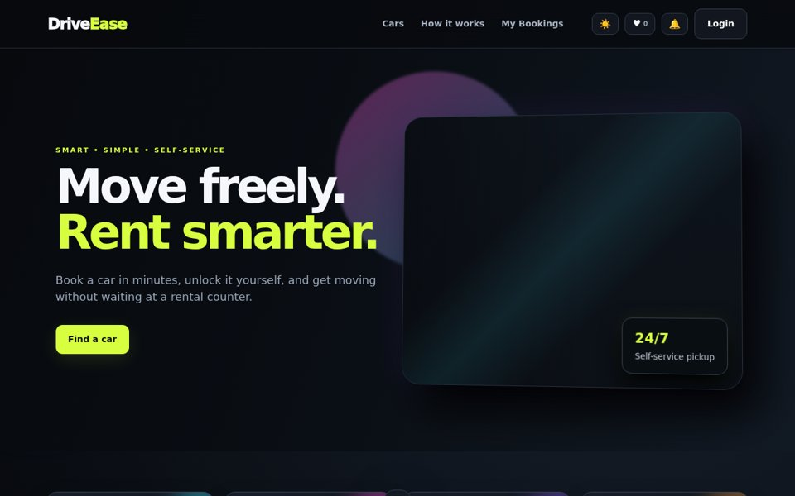
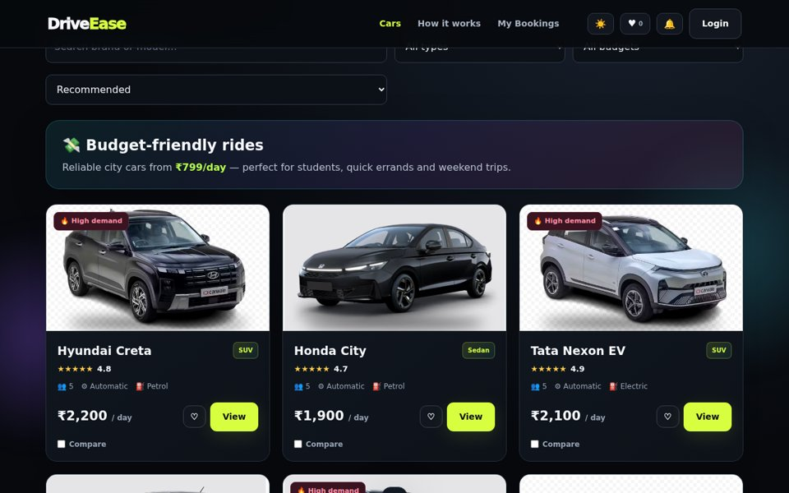
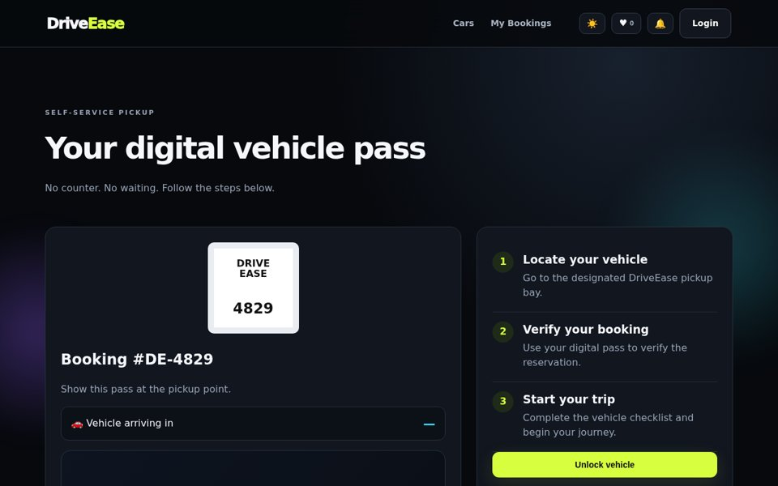
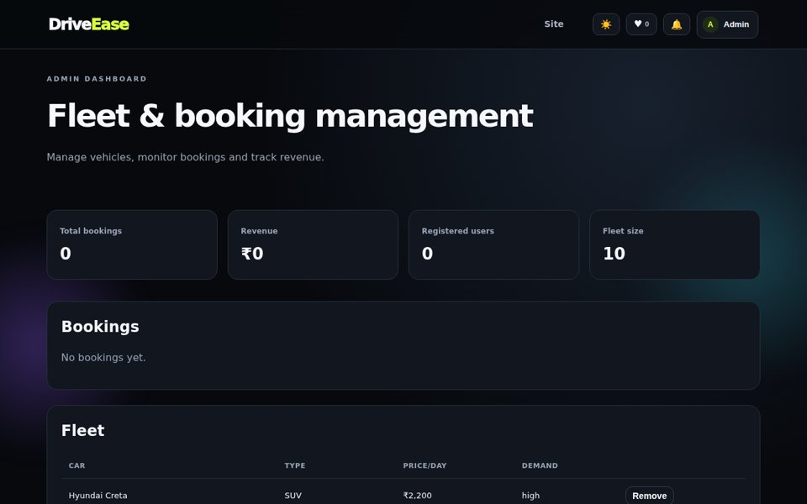
Implementation: DriveEase Prototype
Working front-end screens of the self-service rental flow
Flow demonstrated
Home, search and filters
Car details, compare, reviews
Booking, licence upload, coupons
Payment and confirmation
Digital vehicle pass for self-service pickup
My bookings and admin dashboard
Home
Available cars
Front-end prototype: data is simulated in browser localStorage, standing in for the relational tables. Payment, licence check and GPS are simulated.
Digital vehicle pass
Admin dashboard

Slide 13
Technology Stack
Tools selected for the project
HTML5, CSS3, JavaScript
Responsive card-based interface; fetch calls to the REST API.
Node.js + Express.js
Event-driven server, routing, middleware and REST endpoints.
MySQL (InnoDB)
Relational store with ACID transactions, row-level locking and foreign keys.
JWT + bcrypt
Password hashing and token-based, role-aware access control.
Postman
Designs, sends and automates API test requests.
Git & GitHub
Feature branches, pull requests and shared source code.

Slide 14
Conclusion & Future Scope
Summary and next development steps
Conclusion
Moves car rental from counters and paperwork to one self-service platform.
Real-time availability, automatic pricing and online payment.
Locking transactions prevent double booking.
3NF schema applies ER modelling, advanced SQL, views and triggers.
Future scope
Live GPS tracking and keyless / smart-lock access
Real payment gateway and digital document verification
AI recommendations and dynamic pricing
EV charging integration and push notifications
Native mobile apps and multi-city expansion
THANK YOU • QUESTIONS?

